Slide 1


Department of Computer Science
Course: Mini Project Code: BCA481-5
Sikhado – A Secure Platform for Connecting Great Learners and Great Minds Alike
Alyssa Diona Rego – 2341602 / David Abraham – 2341620 / Pranav M Pradeep – 2341651
Mission
Christ University is a nurturing ground for an individual’s holistic development to make effective contribution
to the society in a dynamic environment
Vision
Excellence and Service
Core Values
Faith in God | Moral Uprightness
Love of Fellow Beings | Social Responsibility
Pursuit of Excellence
CHRIST (Deemed to be University)
Excellence & Service

Slide 2



Problem Statement
Existing platforms such as Fiverr, Upwork, and LinkedIn Learning allow freelancing, tutoring, or skill-sharing, but are generalized for global markets.
Fiverr and Upwork offer gig-based project listings, secure payment handling, and profile systems. LinkedIn Learning supports skill-based video tutorials and professional networking.
However, none of these systems are tailored exclusively for internal academic ecosystems with verified access or institutional collaboration.
This results in lost opportunities for peer learning, mentorship, and internal knowledge exchange — especially in a controlled and academically relevant environment.
CHRIST (Deemed to be University)
Excellence & Service
‹1›
Notes:
‹#›

Slide 3

Project Title
Sikhado
A Secure Platform for Connecting Great Learners and Great Minds Alike
CHRIST (Deemed to be University)
Excellence & Service
‹2›
Notes:
‹#›

Slide 4
About Sikhado
Sikhado is a secure academic networking platform designed to connect students, professors, and
alumni within a verified institutional ecosystem.
It enables users to offer or avail micro-services, mentorship, or learning support exclusively within the organization, promoting internal collaboration, skill development, and professional engagement.
Unlike traditional freelancing or tutoring sites, Sikhado ensures institutional verification using academic email authentication and role-based access. The system supports secure payments, feedback ratings, portfolio building, and a mentorship framework.
A secure academic networking platform that connects students, professors, and alumni for offering or availing micro-services, mentorship, and academic support within a verified institutional ecosystem, bridges the gap between learning and earning while maintaining the integrity and
privacy of the institution.
CHRIST (Deemed to be University)
Excellence & Service
‹3›
Notes:
‹#›

Slide 5
Objectives
Design and develop a secure, institution-verified platform to connect students, teachers, and alumni.
Implement role-based access and email verification to restrict usage to authorized users.
Enable micro-job/task posting and mentorship
Request functionalities within the system.
Integrate secure online payment gateways such as Razorpay or Stripe to process service fees.
Allow users to build portfolios, receive ratings, and track completed services or learning activities
Provide an intuitive and responsive UI to facilitate seamless user interaction across
devices.
Promote skill-sharing and academic collaboration within a safe, internal environment.
CHRIST (Deemed to be University)
Excellence & Service
‹4›
Notes:
‹#›

Slide 6


SDG GOALS SIKHADO SUPPORTS
SDG Goal 4:
Quality Education: Promote inclusive, quality education by enabling continuous learning, mentorship, and skill development within a trusted academic network.
SDG Goal 8:
Decent Work and Economic Growth by fostering decent work and sustainable economic opportunities within academic communities
CHRIST (Deemed to be University)
Excellence & Service
‹5›
Notes:
‹#›

Slide 7

Community Partner
Universities
Universities can partner with Sikhado to provide a secure space where students, professors, and alumni can connect, share skills, offer mentorship, and support learning within a trusted academic platform.
CHRIST (Deemed to be University)
Excellence & Service
‹6›
Notes:
‹#›

Slide 8
Functionalities of Sikhado
Sikhado provides a secure, academic-only digital platform where:
Users register using verified academic emails.
Role-based access (Student, Professor, Alumni) determines available features.
Services can be listed (e.g., tutoring, design help) and availed with in-platform project boards.
Mentorship requests connect juniors with senior students or faculty.
Payments are managed using net banking, to ensure service satisfaction.
Users can maintain skill portfolios, receive reviews/ratings, and showcase
badges/certificates.
Admins monitor platform activity and resolve disputes.
CHRIST (Deemed to be University)
Excellence & Service
‹7›
Notes:
‹#›

Slide 9



Tools and Technologies
Frontend Development:
• HTML5
• CSS3
• Bootstrap
• JavaScript
Backend Development:
• MySQL , XAMPP, Python
Database Management:
• MySQL PHP (for structured
user, project, and
transaction data)
Payment Integration:
Net Banking
Card
UPI
CHRIST (Deemed to be University)
Excellence & Service
‹8›
Notes:
‹#›

Slide 10
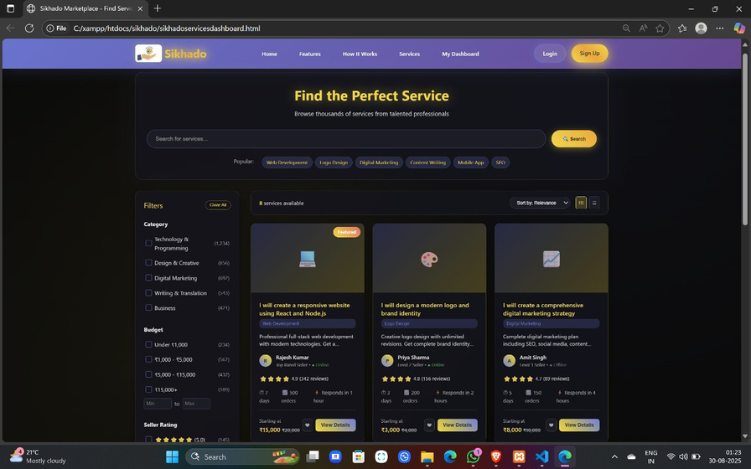
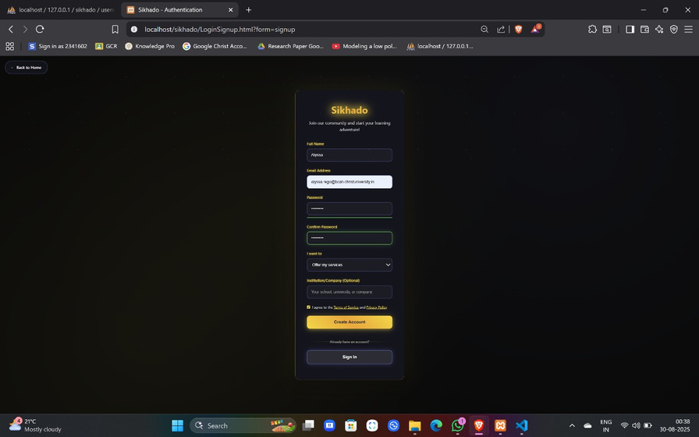
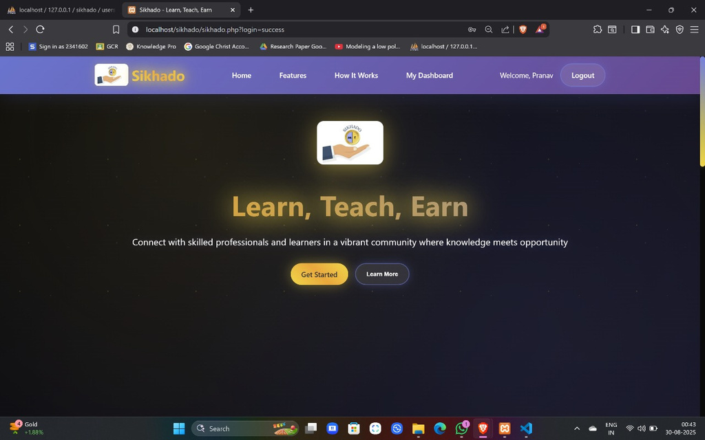
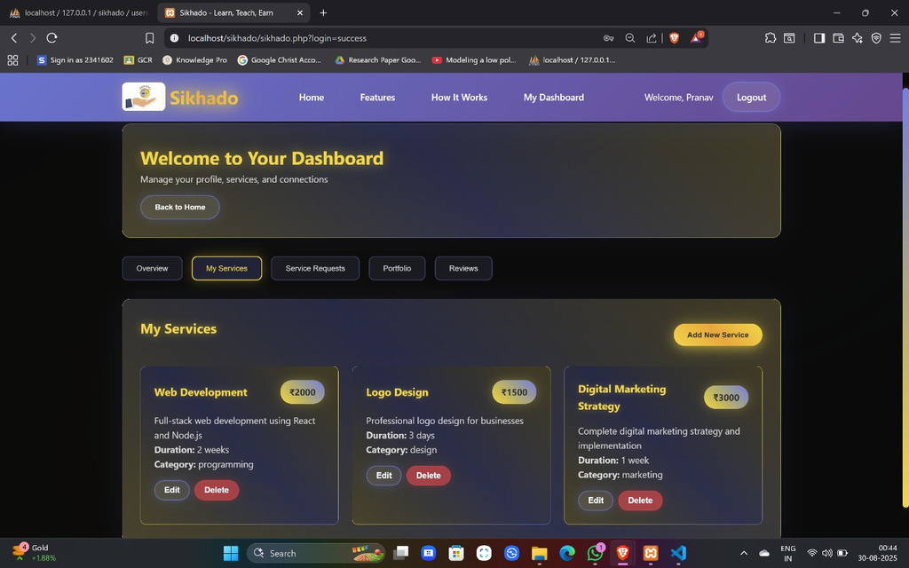
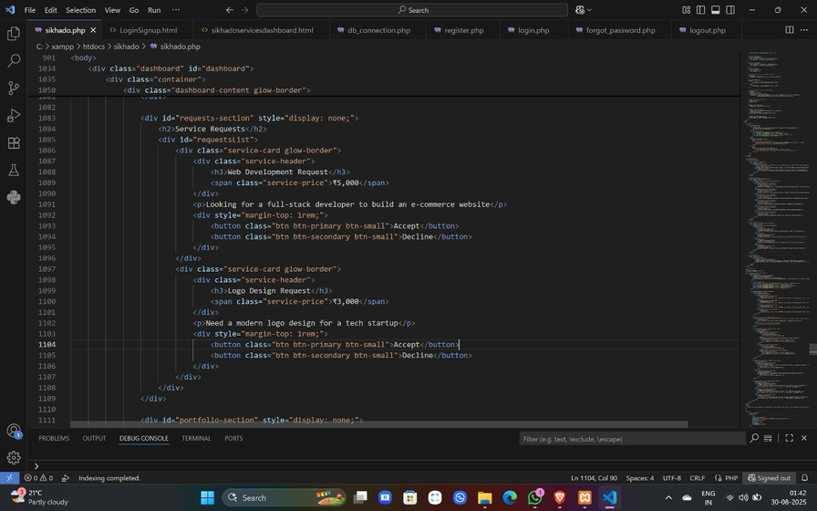
Website demo
CHRIST (Deemed to be University)
Excellence & Service
‹9›
Notes:
‹#›

Slide 11
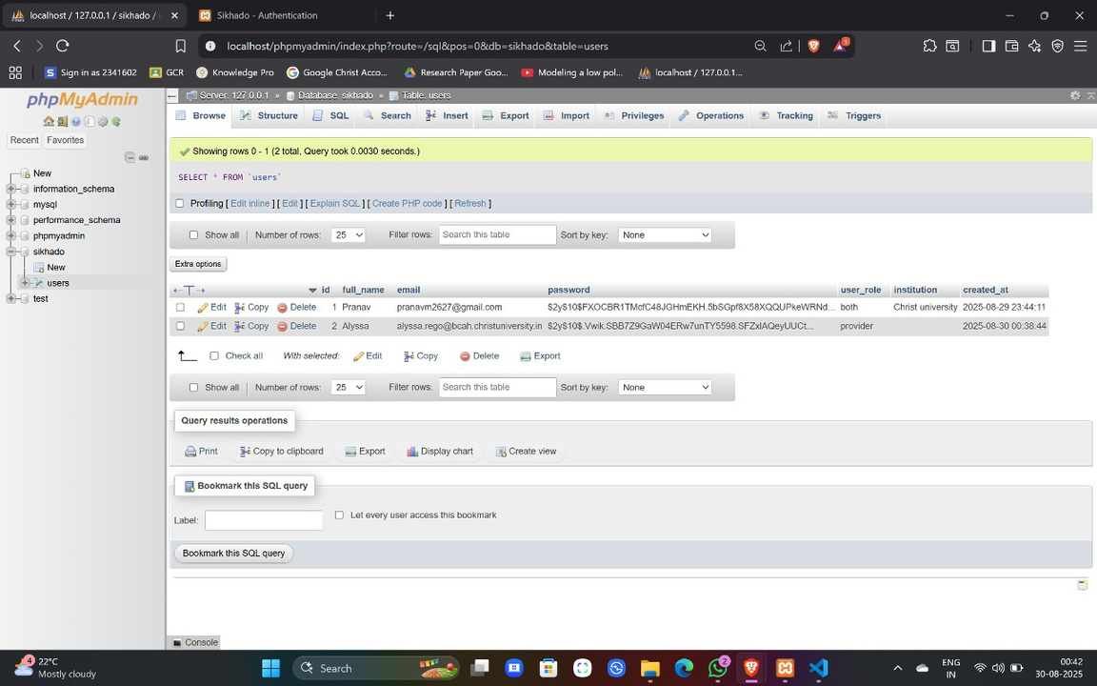
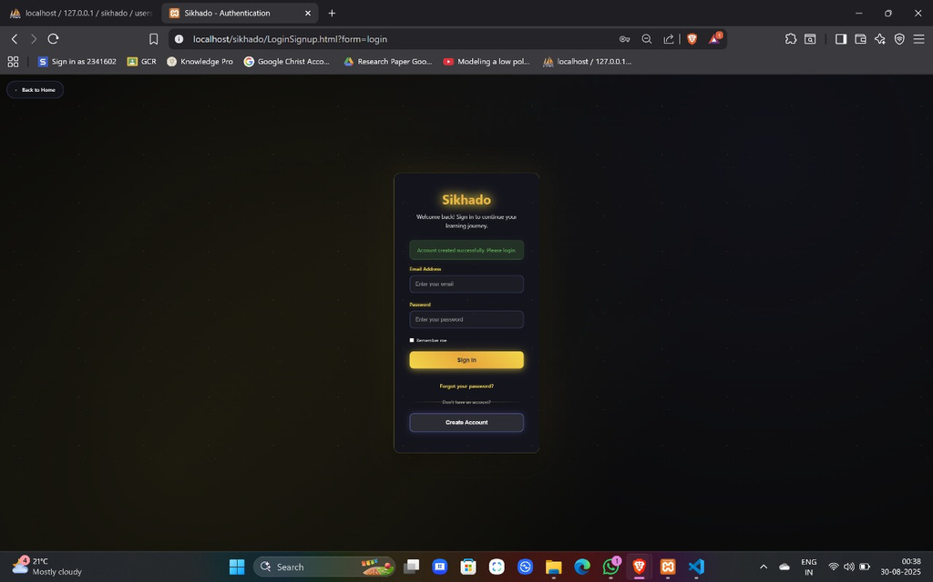
Database connection
Database connection was established through xampp and Php, Mysql
CHRIST (Deemed to be University)
Excellence & Service
‹10›
Notes:
‹#›

Slide 12
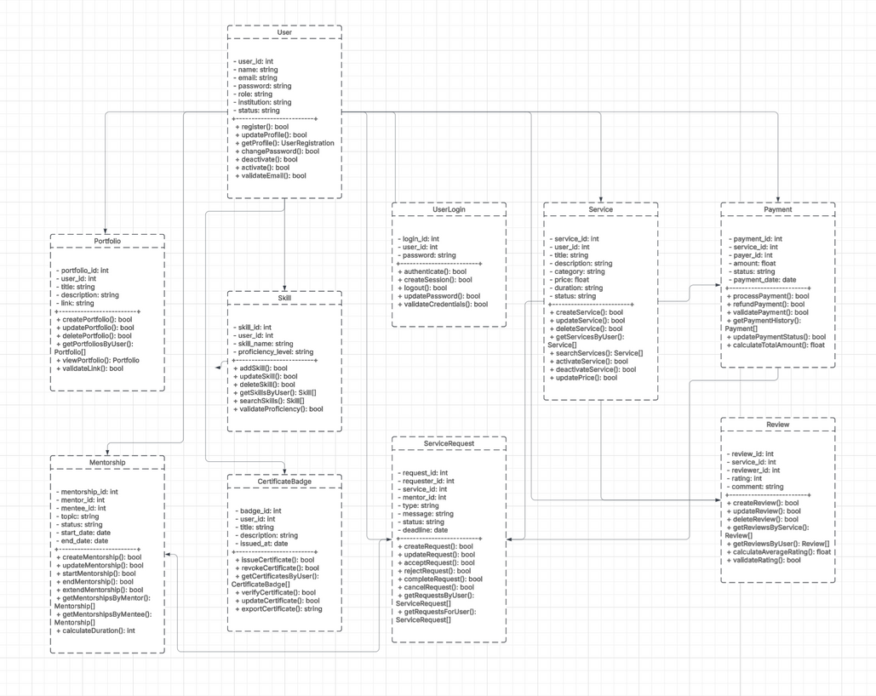
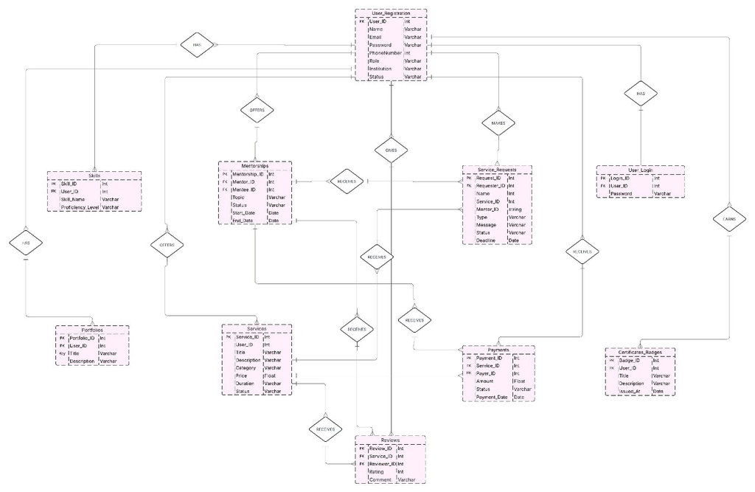
Database ER Diagram and Class Diagram
CHRIST (Deemed to be University)
Excellence & Service
‹11›
Notes:
‹#›

Slide 13
Thank You
CHRIST (Deemed to be University)
Excellence & Service
‹12›
Notes:
‹#›

